Slide 1

RESEARCH SUMMER 2021 WEEKLY REVIEW
Nile Coble Weekly Review

Slide 2
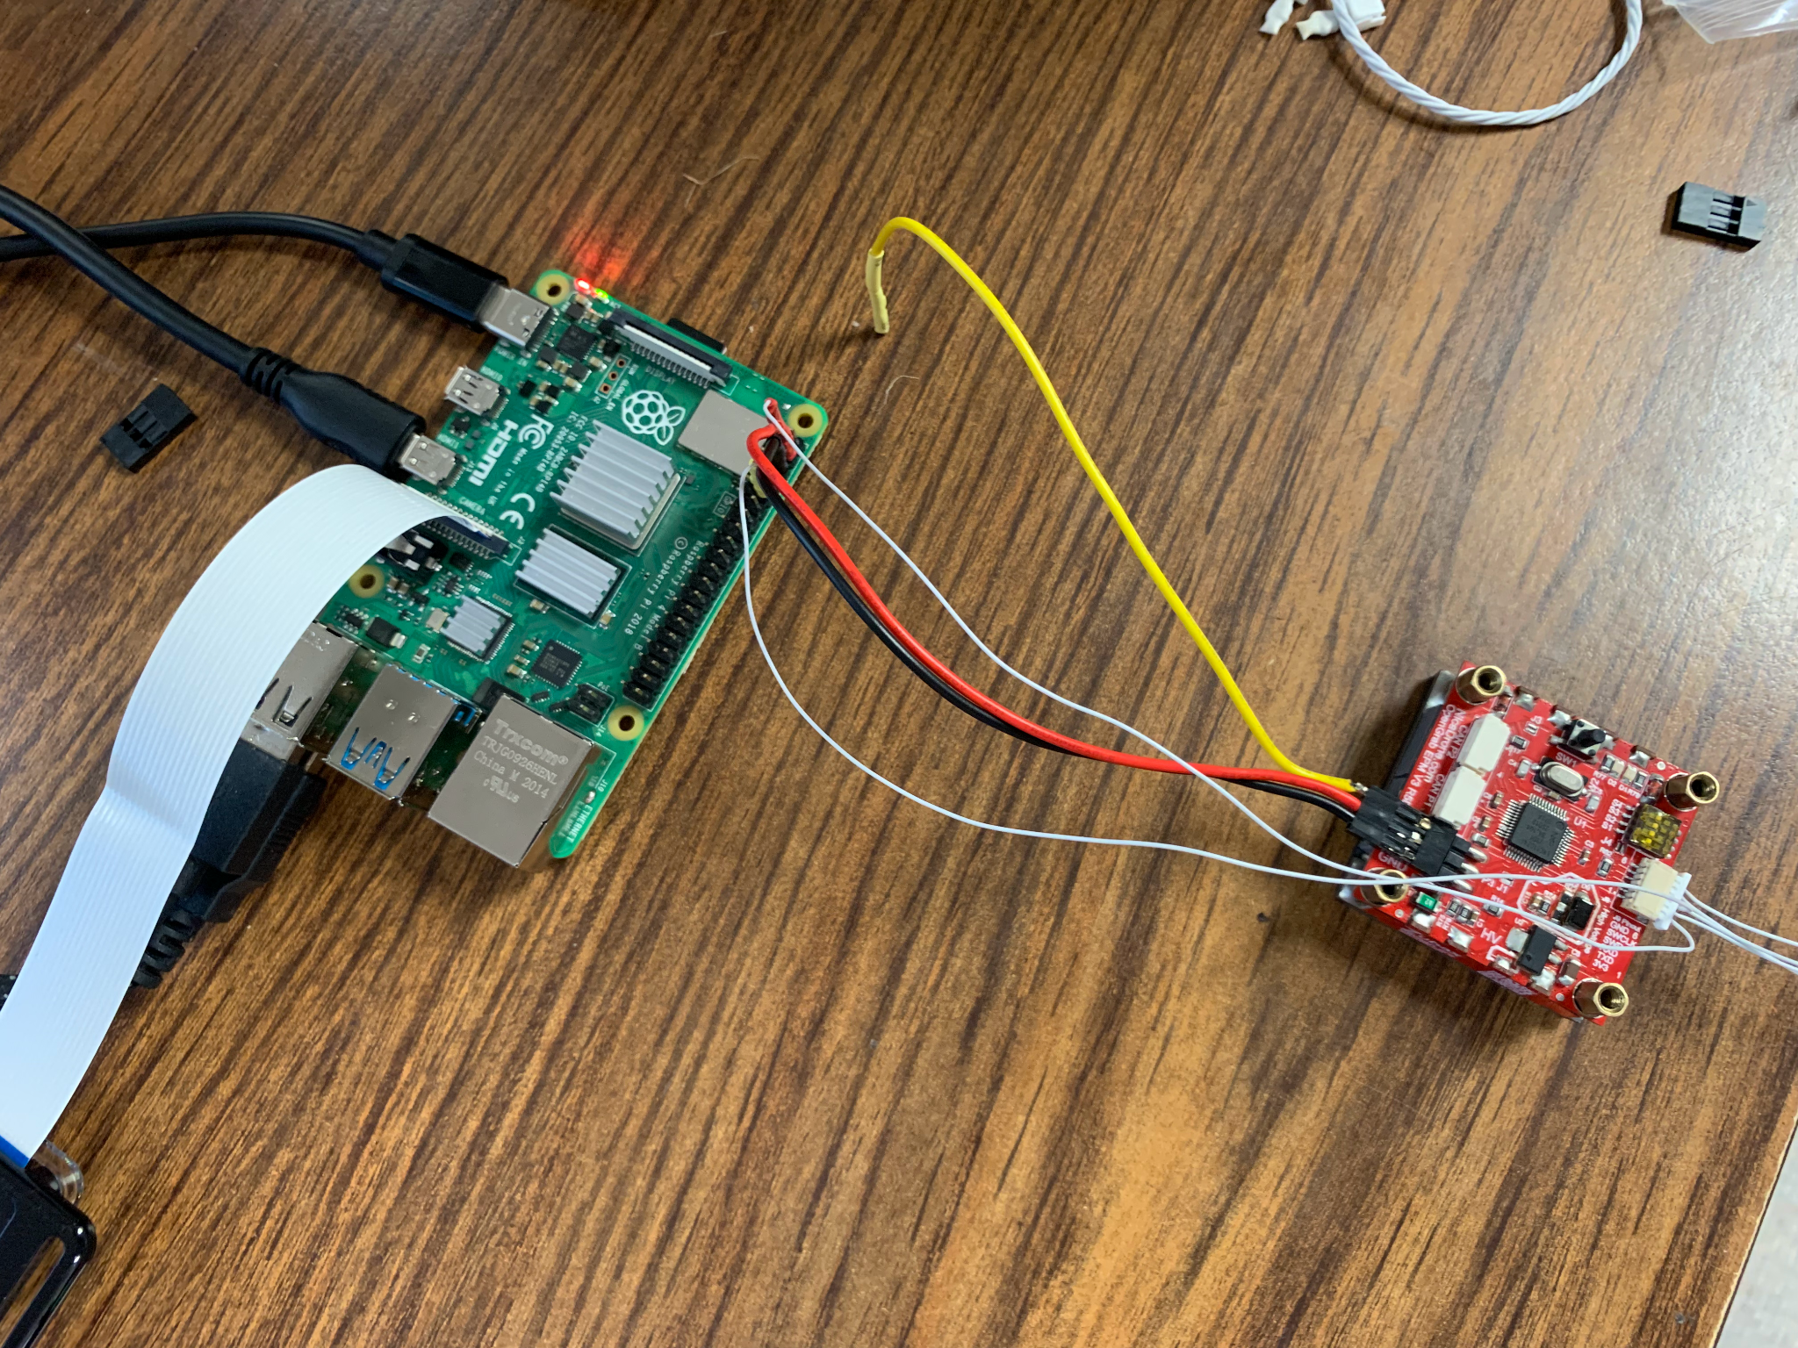
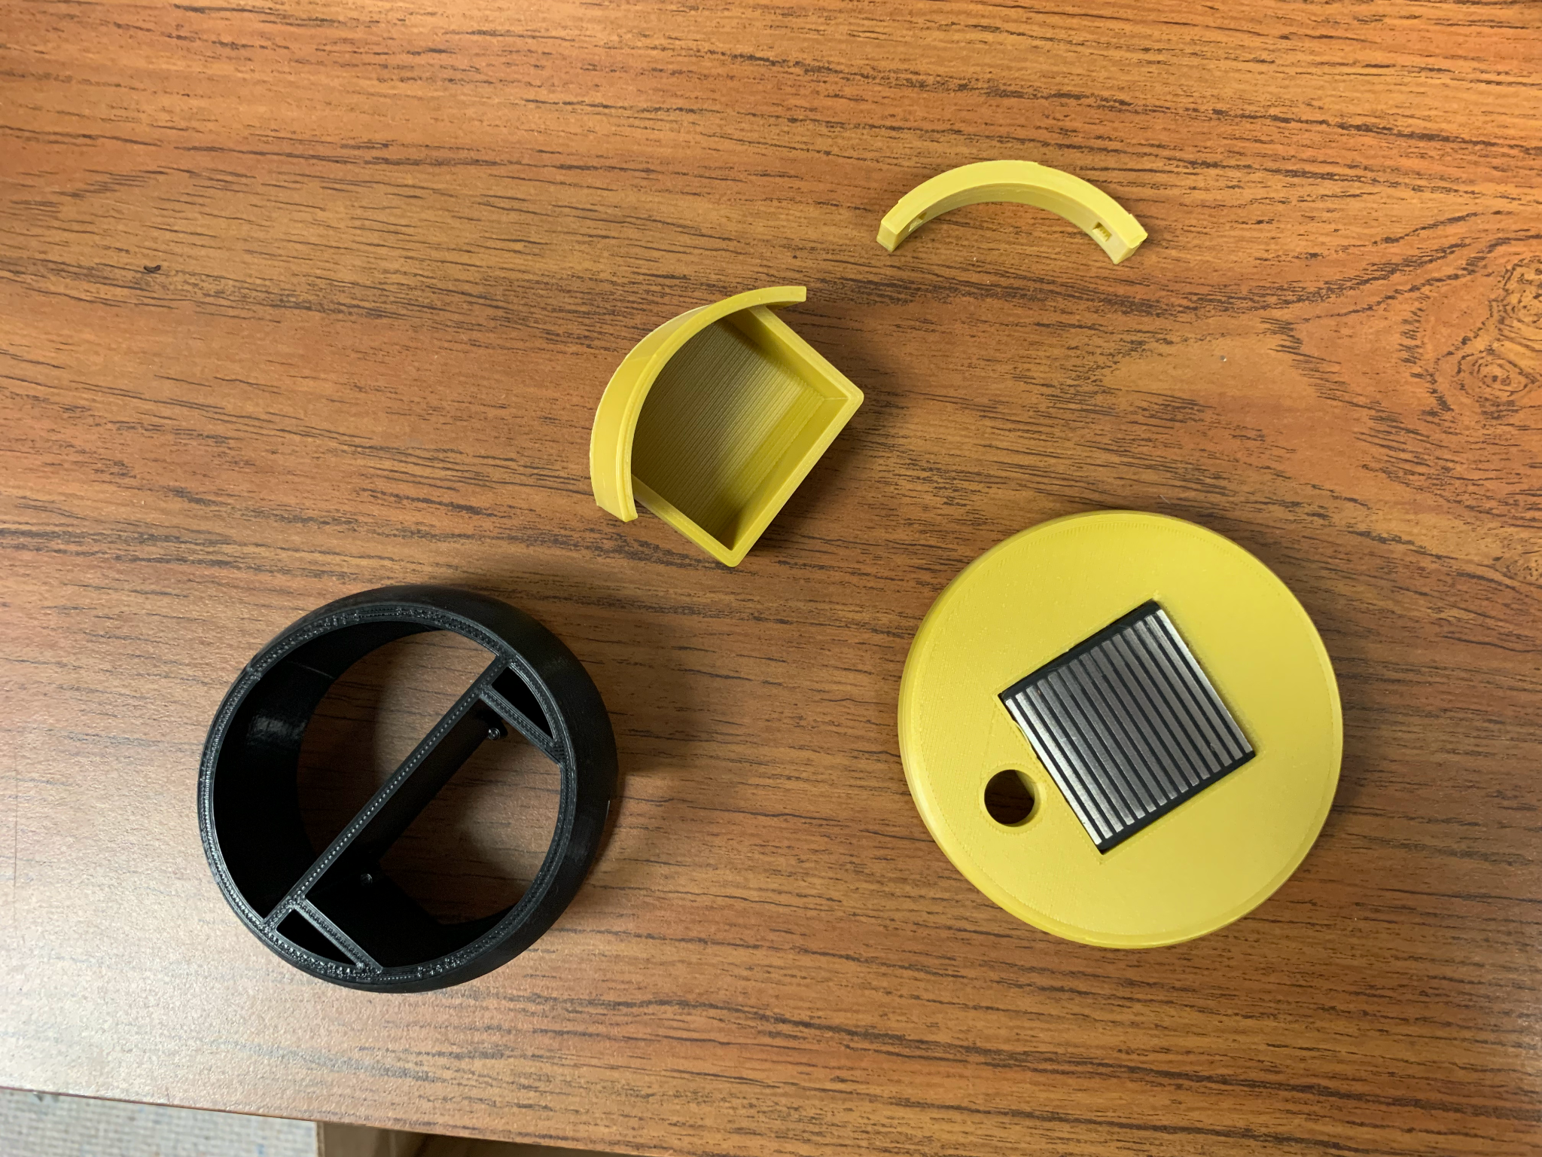
Designed more parts
Got the electropermanent magnet to work.

Slide 3
Sign | Action
TESTMSG | Blink LED
TAKEPIC | Take picture
DEEPLOY | Activate electropermanent magnet
SUICIDE | Deactivate electropermanent magnet
The package can accept different commands and act on them.

Slide 4
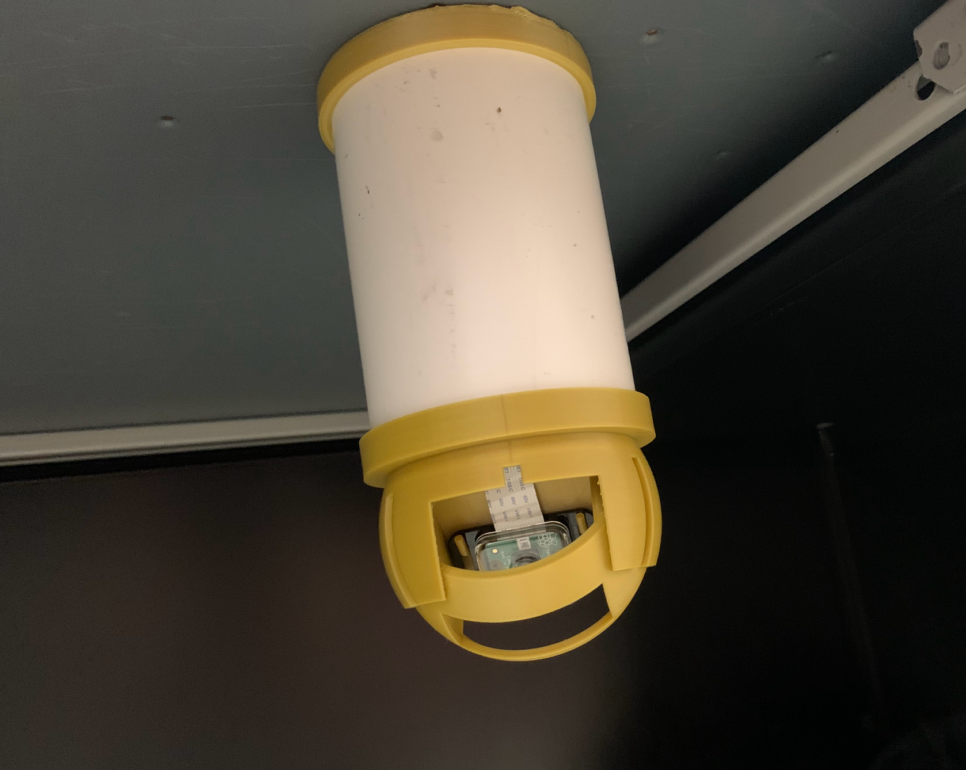
Next Up:
Field distance test
Deployment
Come up with cool name (suggestions appreciated)

Slide 5
THANK YOU

